Slide 1
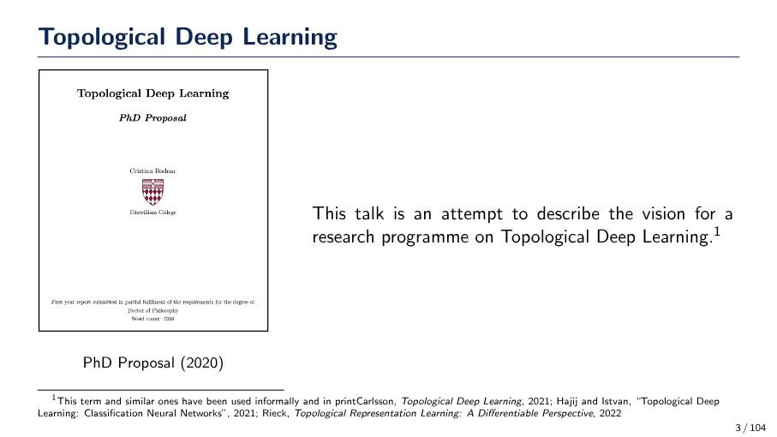
Purpose of the Talk on Topological Deep Learning
This talk aims to describe the vision for a research program on Topological Deep Learning, stemming from a 2020 PhD proposal. The term has been used in works by Carlsson (2021), Hajiji and Istvan (2021), and Rieck (2022).
Source: Page 3

Slide 2
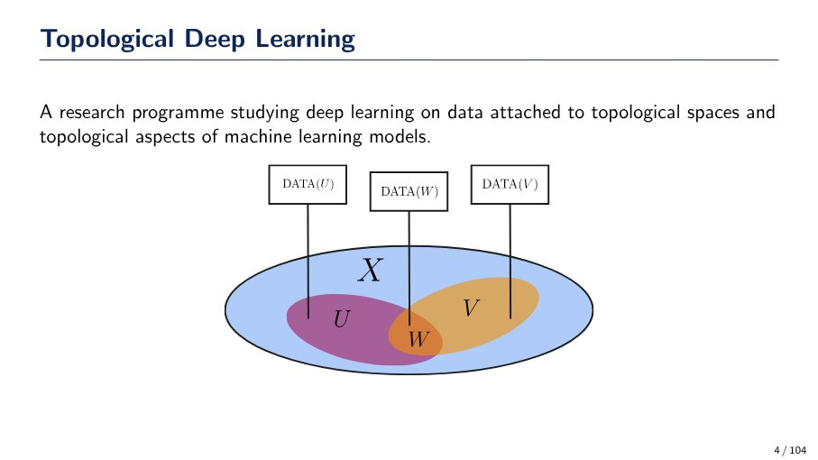
Defining Topological Deep Learning
Topological Deep Learning is a research program that explores two main areas:
- Applying deep learning techniques to data that is intrinsically associated with topological spaces.
- Analyzing and understanding the topological characteristics and structures inherent in machine learning models.
The accompanying diagram illustrates data (DATA(U), DATA(W), DATA(V)) linked to specific subsets (U, W, V) within a larger topological space (X), where W is the intersection of U and V.
Source: Page 4

Slide 3

Geometric Deep Learning: Structured Data
Geometric Deep Learning applies deep learning to data residing on non-Euclidean, structured domains such as molecules, meshes, and manifolds. This approach is essential because much real-world data inherently possesses geometric structure, as illustrated by applications in protein structure prediction and bioactive molecule design.
Source: Page 5

Slide 4
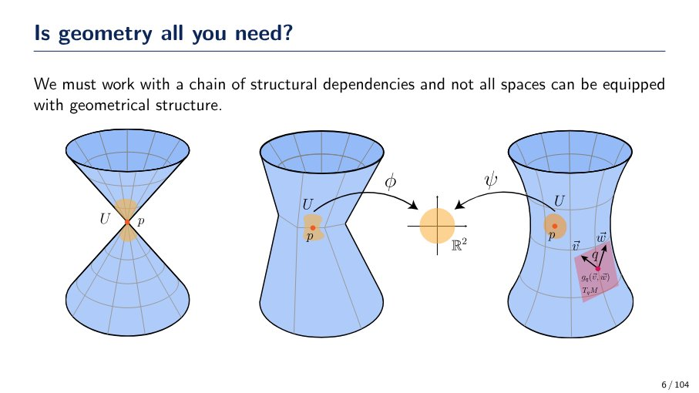
Manifolds and geometric structure
Not all spaces can be equipped with a purely geometrical structure, necessitating a chain of structural dependencies. Manifolds are spaces that are locally Euclidean, meaning regions (U) can be mapped to R^2 via charts (φ, ψ). While the manifold itself may lack a global geometric structure, local geometric properties, such as the inner product of tangent vectors (v, w) at a point q, can be defined on its tangent spaces (T_qM) using a metric tensor (g_q(v, w)).
Source: Page 6

Slide 5
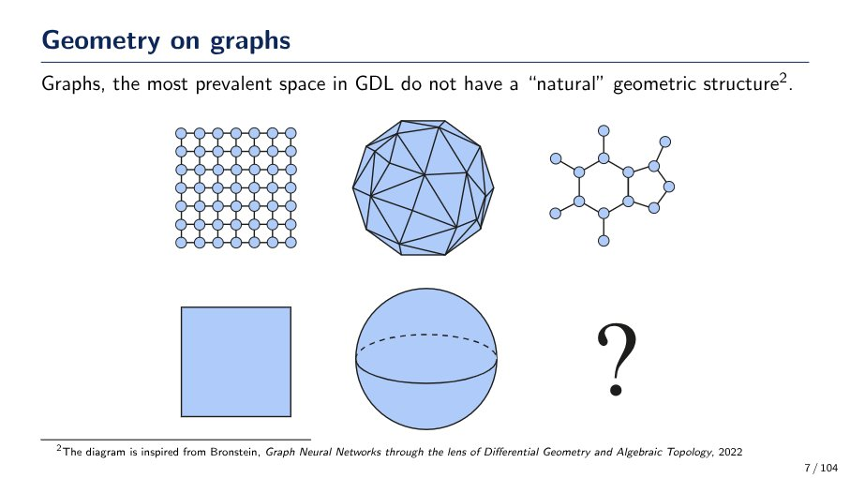
Graphs and natural geometric structure
Graphs, a prevalent data space in GDL, lack a "natural" geometric structure, unlike traditional geometric objects such as squares or spheres. This slide illustrates various graph types (grid, complex polyhedral, molecular) and contrasts them with standard geometric shapes, posing the question of how to define or understand the geometry of graphs.
Source: Page 7

Slide 6
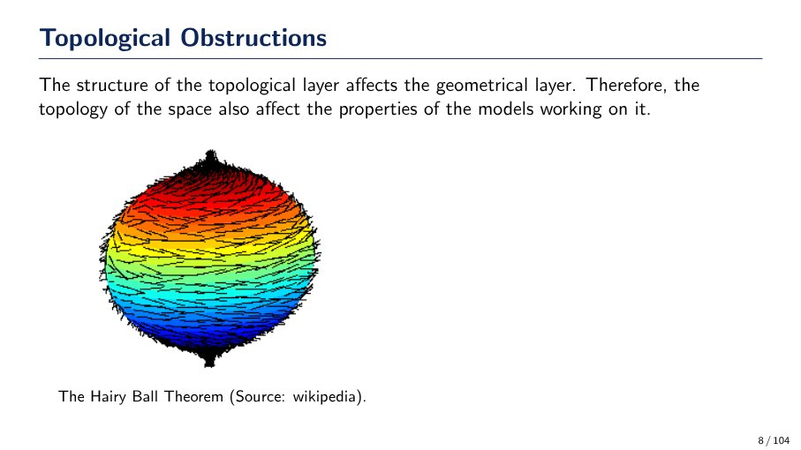
Topological Obstructions and the Hairy Ball Theorem
Topological obstructions occur because the structure of the topological layer influences the geometrical layer. This means the topology of a space affects the properties of models operating within it. The Hairy Ball Theorem is a key example, illustrating that it's impossible to comb the hair flat on a sphere without creating at least one 'cowlick' (a point where the vector field is zero).
Source: Page 8

Slide 7
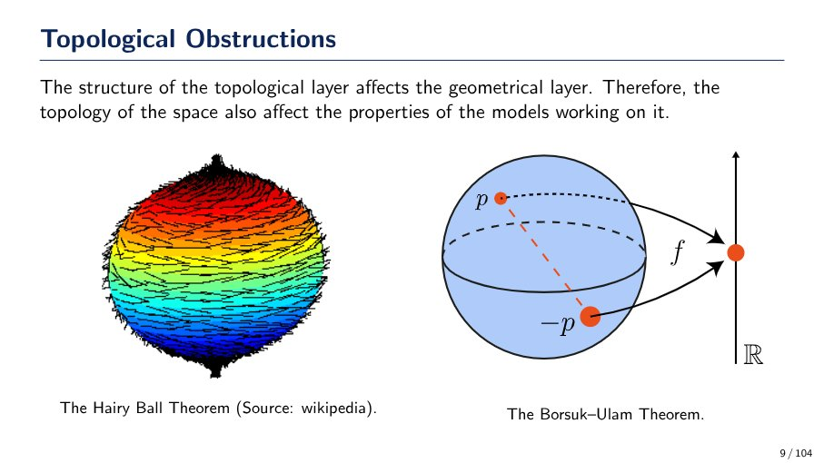
Topological Obstructions
Topological obstructions highlight how the underlying topology of a space affects its geometrical properties and the behavior of models. Two key examples are:
- **The Hairy Ball Theorem:** States that it's impossible to comb a sphere's 'hair' (a continuous tangent vector field) flat without creating at least one 'cowlick' (a point where the vector is zero).
- **The Borsuk-Ulam Theorem:** For any continuous map from an n-sphere to n-dimensional Euclidean space, there exists at least one pair of antipodal points that map to the same point.
Source: Page 9

Slide 8
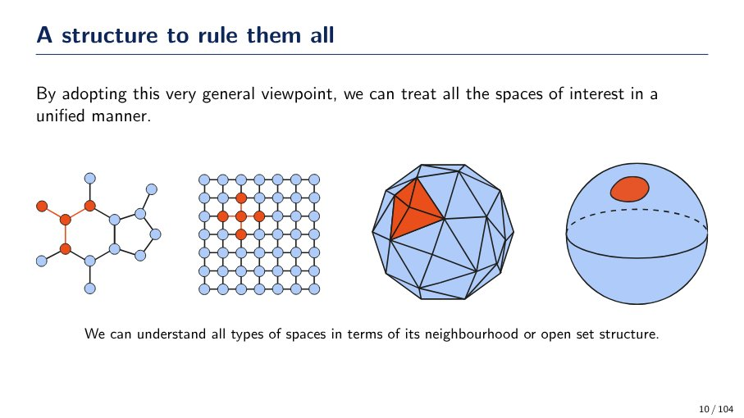
Unified understanding of spaces through neighborhoods
Various types of 'spaces' (illustrated by graphs, grids, polyhedra, and smooth surfaces) can be treated in a unified manner. This is achieved by understanding them through their fundamental 'neighbourhood' or 'open set structure', providing a general framework for analysis.
Source: Page 10

Slide 9
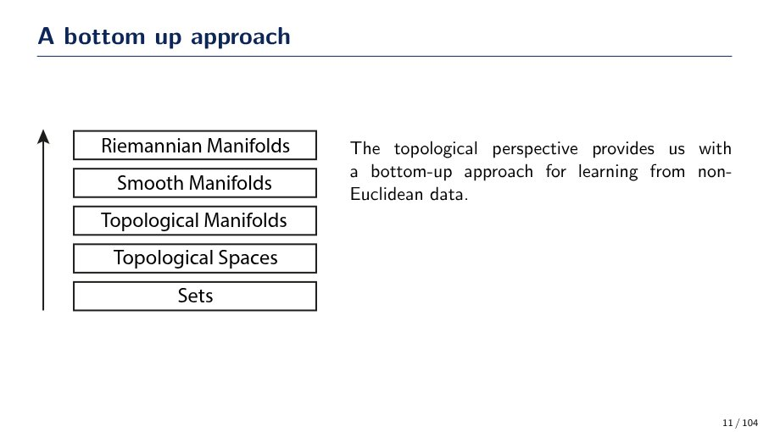
Bottom-up approach to manifolds for non-Euclidean data
The topological perspective provides a bottom-up approach for learning from non-Euclidean data, building complexity through a hierarchy of structures:
* **Sets**: The fundamental collection of elements.
* **Topological Spaces**: Sets endowed with a topology (open sets).
* **Topological Manifolds**: Topological spaces that locally resemble Euclidean space.
* **Smooth Manifolds**: Topological manifolds with a differentiable structure.
* **Riemannian Manifolds**: Smooth manifolds equipped with a Riemannian metric, allowing for measurement of distances and angles.
Source: Page 11

Slide 10
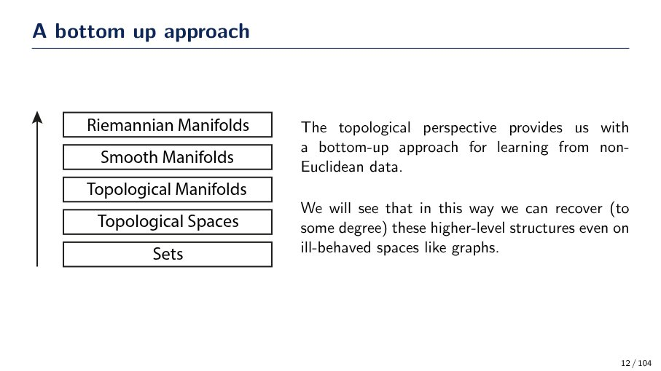
Bottom-up approach for non-Euclidean data
The topological perspective provides a bottom-up approach for learning from non-Euclidean data. This hierarchy progresses from fundamental 'Sets' to 'Topological Spaces', 'Topological Manifolds', 'Smooth Manifolds', and finally 'Riemannian Manifolds'. This method allows for the recovery of higher-level structures, even in ill-behaved spaces like graphs.
Source: Page 12

Slide 11
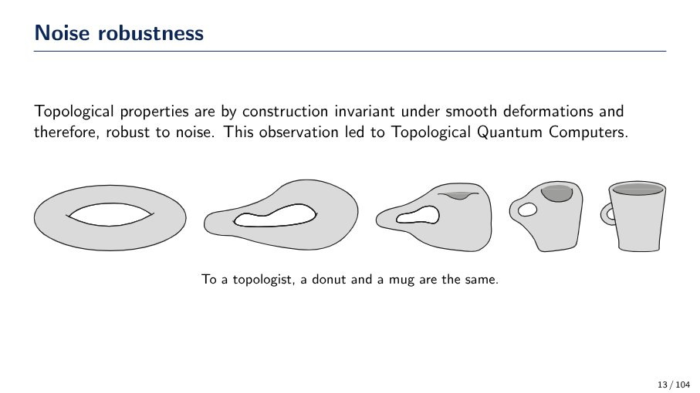
Topological properties and noise robustness
Topological properties are inherently robust to noise because they are invariant under smooth deformations (continuous changes in shape without tearing or gluing). This means their fundamental characteristics (like the number of holes) remain unchanged despite physical distortions. This principle is foundational to Topological Quantum Computers, which aim for noise-resilient computation. For example, a topologist considers a donut and a coffee mug to be the same, as one can be smoothly deformed into the other.
Source: Page 13

Slide 12
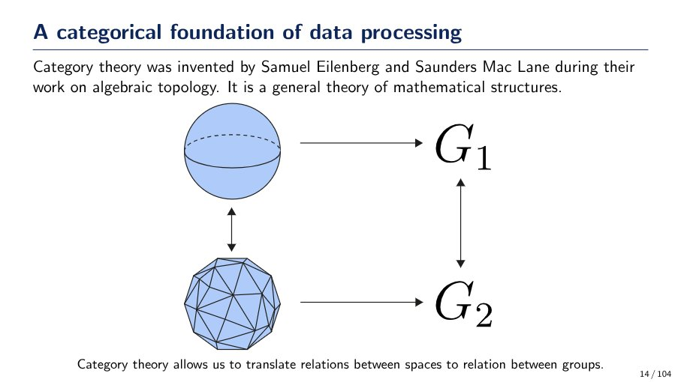
Category Theory: Foundation for Data Processing
Category theory, invented by Samuel Eilenberg and Saunders Mac Lane, is a general theory of mathematical structures. It allows for the translation of relations between spaces (e.g., a sphere and a polyhedron) to relations between groups (G1 and G2), providing a framework for data processing.
Source: Page 14

Slide 13
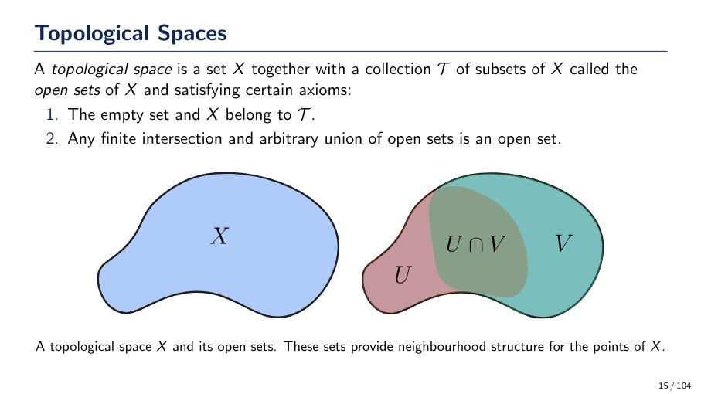
What defines a Topological Space?
A topological space is a set X together with a collection T of subsets of X (called open sets) satisfying these axioms:
1. The empty set (∅) and the set X itself belong to T.
2. Any finite intersection of open sets in T is also an open set.
3. Any arbitrary union of open sets in T is also an open set.
These open sets provide a neighborhood structure for the points of X.
Source: Page 15

Slide 14
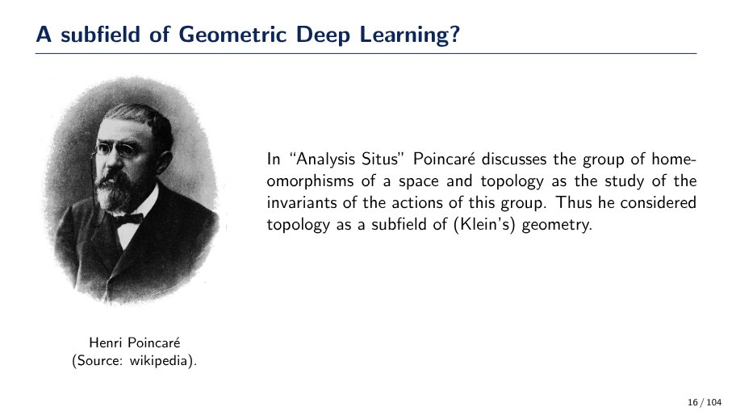
Poincaré on Topology & Geometry
Henri Poincaré, in "Analysis Situs", viewed topology as the study of invariants of homeomorphisms of a space. He considered topology a subfield of (Klein's) geometry.
Source: Page 16

Slide 15
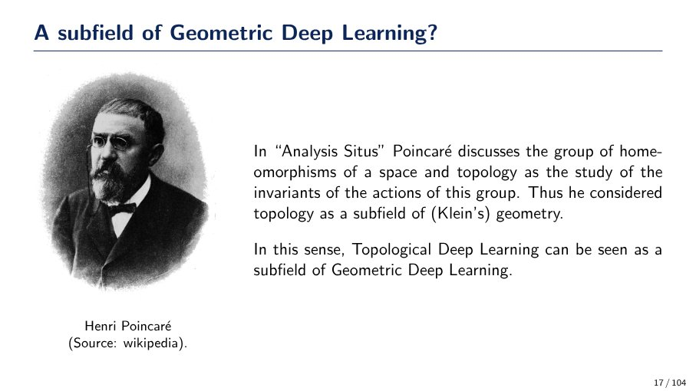
How does Poincaré's view connect Topology to Geometric Deep Learning?
Henri Poincaré, in "Analysis Situs", discussed topology as the study of invariants of homeomorphisms, considering it a subfield of Klein's geometry. In this context, Topological Deep Learning can be seen as a subfield of Geometric Deep Learning.
Source: Page 17

Slide 16
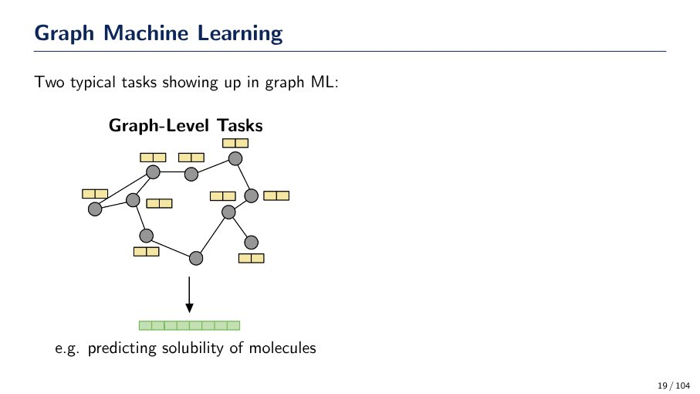
Graph-Level Tasks in ML
Graph-level tasks in Machine Learning involve processing an entire graph structure, including its nodes and their associated features, to predict a single output or property for the whole graph. An example is predicting the solubility of molecules, where each molecule is represented as a graph.
Source: Page 19

Slide 17
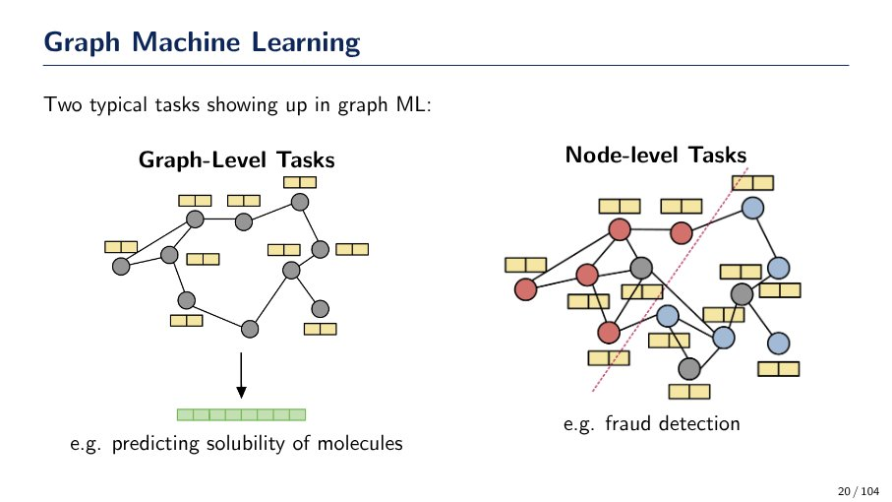
Graph Machine Learning Tasks
Graph Machine Learning (ML) typically involves two types of tasks:
- **Graph-Level Tasks**: These tasks focus on making predictions or classifications for the entire graph structure. An example is predicting the solubility of molecules, where each molecule is represented as a graph.
- **Node-Level Tasks**: These tasks involve making predictions or classifications for individual nodes within a graph. An example is fraud detection, where nodes (e.g., transactions or users) are classified as fraudulent or legitimate.
Source: Page 20

Slide 18
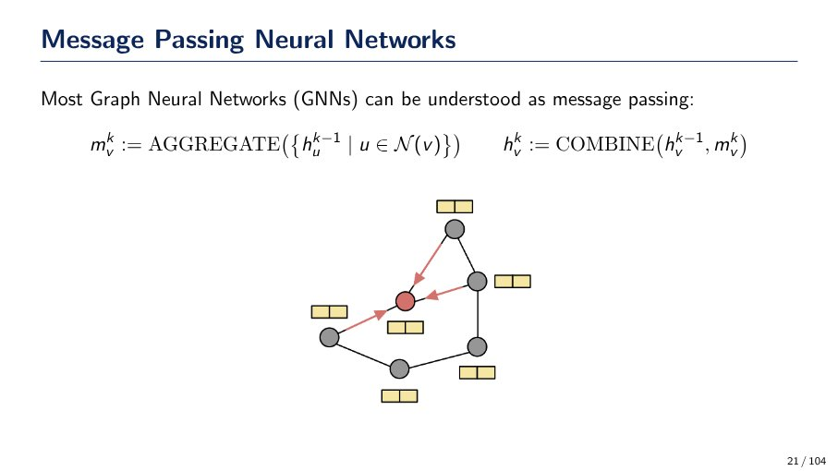
Message Passing Neural Networks (MPNNs)
Most Graph Neural Networks (GNNs) can be understood as message passing, involving two main steps for each node 'v' at iteration 'k':
- **Message Aggregation (`m_v^k`):** Messages are aggregated from neighboring nodes `u` (represented by their previous embeddings `h_u^{k-1}`) using an `AGGREGATE` function: `m_v^k := AGGREGATE({h_u^{k-1} | u ∈ N(v)})`.
- **Node Update (`h_v^k`):** The node's embedding is updated by combining its previous embedding `h_v^{k-1}` with the aggregated message `m_v^k` using a `COMBINE` function: `h_v^k := COMBINE(h_v^{k-1}, m_v^k)`.
The diagram visually depicts messages flowing from neighbors to a central node.
Source: Page 21

Slide 19
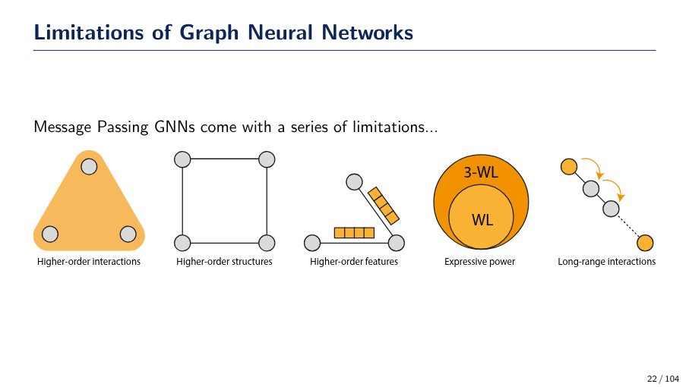
Limitations of Message Passing GNNs
Message Passing Graph Neural Networks (GNNs) face several limitations:
- **Higher-order interactions:** Struggle to capture complex relationships beyond pairwise connections.
- **Higher-order structures:** Limited in distinguishing intricate structural patterns.
- **Higher-order features:** Difficulty in incorporating features that describe groups of nodes or edges.
- **Expressive power:** Bounded by the 1-Weisfeiler-Leman (WL) test, meaning they cannot differentiate certain non-isomorphic graphs that higher-order WL tests (e.g., 3-WL) can.
- **Long-range interactions:** Inefficient at propagating information over many hops, leading to issues like over-smoothing or vanishing gradients.
Source: Page 22

Slide 20
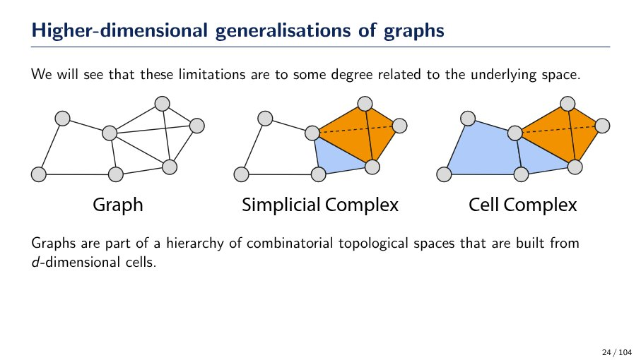
Higher-dimensional generalizations of graphs
Graphs are 1-dimensional combinatorial topological spaces. Higher-dimensional generalizations include:
* **Simplicial Complex:** Built from simplices (points, line segments, triangles, etc.), where the intersection of any two simplices is also a simplex.
* **Cell Complex:** A more general structure built from d-dimensional cells (points, line segments, polygons, polyhedra, etc.), which are not restricted to be simplices.
These structures form a hierarchy of combinatorial topological spaces, addressing limitations of graphs related to their underlying space.
Source: Page 24

Slide 21
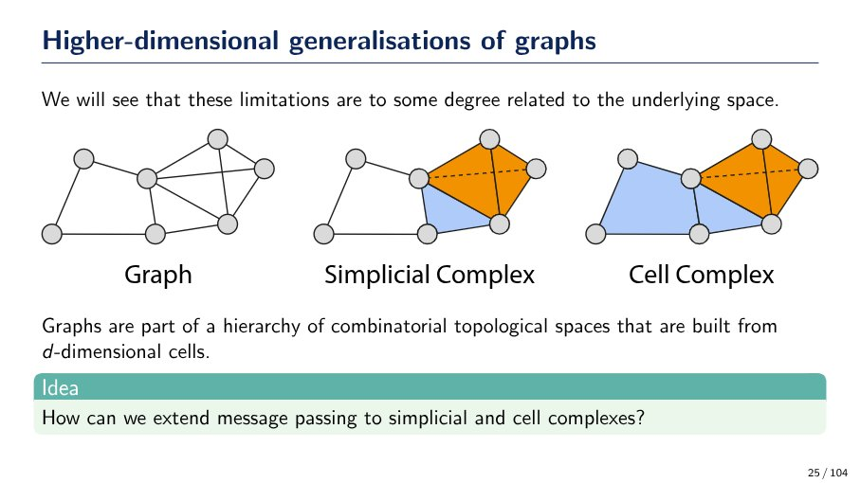
How can message passing be extended to simplicial and cell complexes?
Graphs are 1-dimensional combinatorial topological spaces. Higher-dimensional generalizations include:
- **Simplicial Complexes**: Built from simplices (e.g., points, edges, triangles, tetrahedra).
- **Cell Complexes**: Built from more general d-dimensional cells.
The challenge is to extend message passing techniques, typically used on graphs, to these higher-dimensional structures.
Source: Page 25

Slide 22
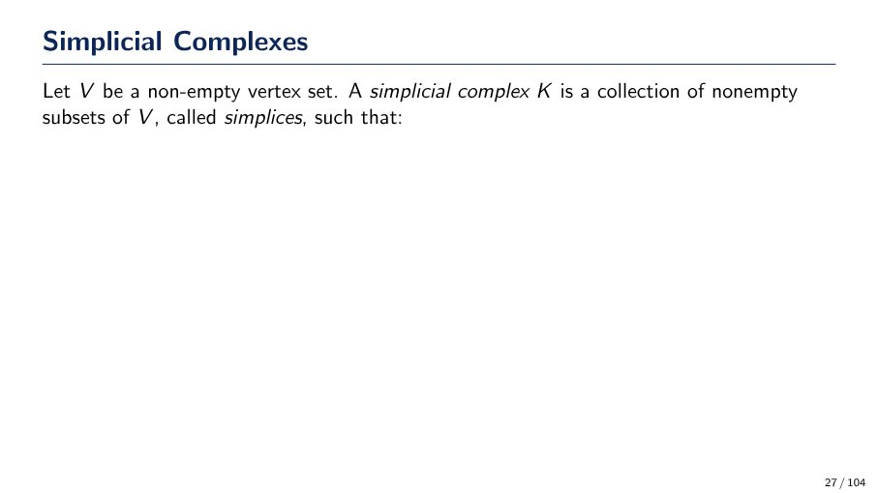
What is a Simplicial Complex?
A simplicial complex K is defined as a collection of non-empty subsets of a non-empty vertex set V. These subsets are referred to as simplices. (The definition is incomplete on this slide, ending with "such that:")
Source: Page 27

Slide 23
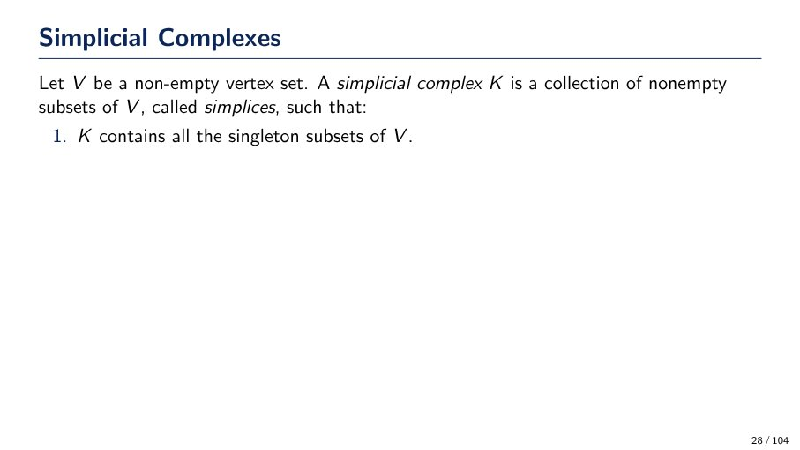
Simplicial Complex Definition (Part 1)
A simplicial complex K is a collection of non-empty subsets of a non-empty vertex set V, called simplices. The first condition for K is that it must contain all the singleton subsets of V.
Source: Page 28

Slide 24
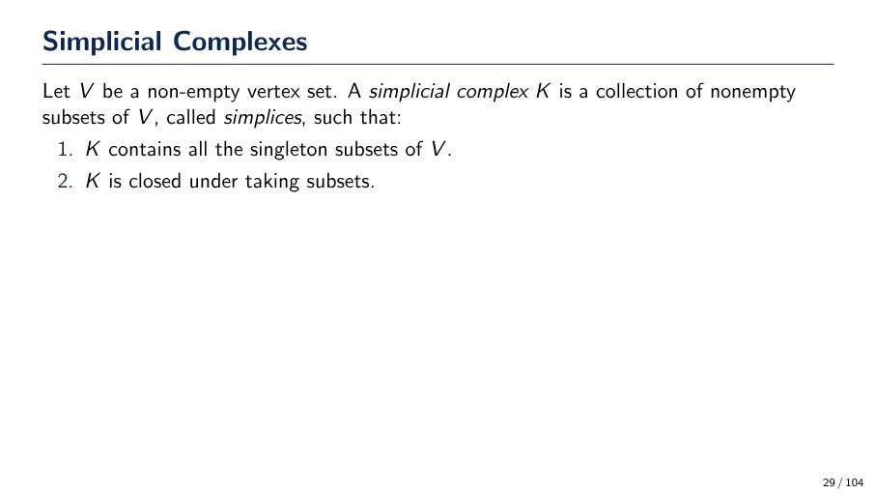
Simplicial Complex Definition
A simplicial complex K is a collection of non-empty subsets of a vertex set V (called simplices) such that:
1. K contains all singleton subsets of V.
2. K is closed under taking subsets (if a set is in K, all its non-empty subsets are also in K).
Source: Page 29

Slide 25
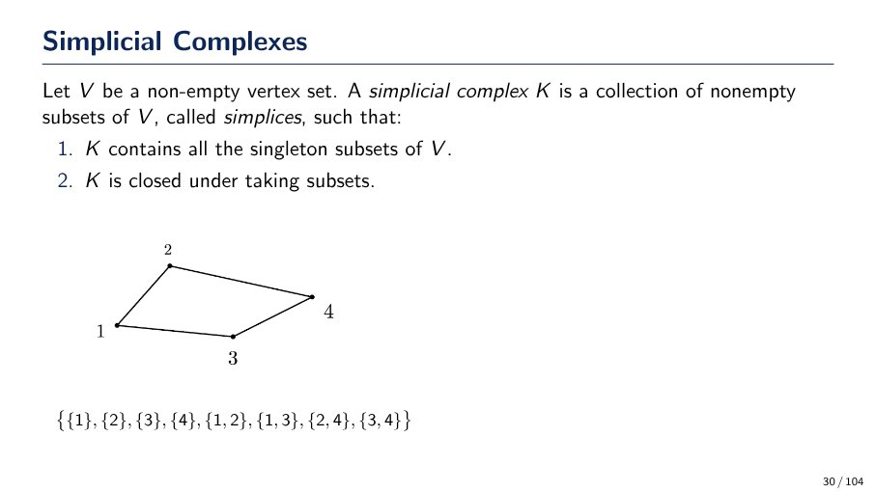
Simplicial Complex Definition
A simplicial complex K is a collection of non-empty subsets (called simplices) of a non-empty vertex set V, such that:
1. K contains all singleton subsets of V.
2. K is closed under taking subsets (if a simplex is in K, all its non-empty subsets are also in K).
Example: For vertices {1, 2, 3, 4}, a complex could be {{1}, {2}, {3}, {4}, {1, 2}, {1, 3}, {2, 4}, {3, 4}}.
Source: Page 30

Slide 26
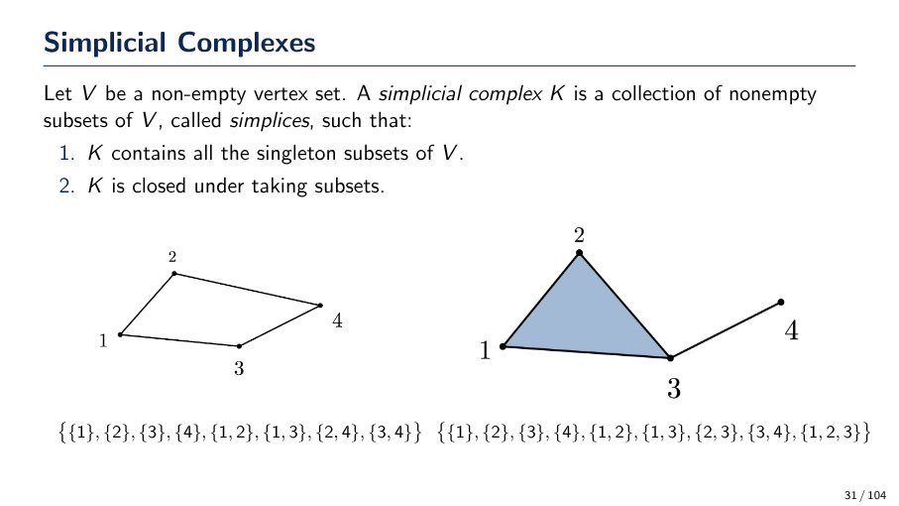
What is a Simplicial Complex?
A simplicial complex K is a collection of non-empty subsets (called simplices) of a non-empty vertex set V, such that:
1. K contains all singleton subsets of V.
2. K is closed under taking subsets (if a simplex is in K, all its non-empty subsets are also in K).
Examples are provided with their corresponding sets of simplices, illustrating these properties.
Source: Page 31

Slide 27
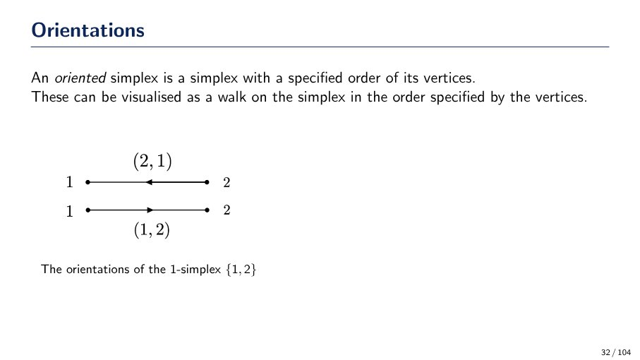
What is an oriented simplex?
An oriented simplex is a simplex with a specified order of its vertices. It can be visualized as a walk on the simplex following the specified vertex order. For a 1-simplex {1,2}, the two possible orientations are (1,2) and (2,1), representing directed edges from 1 to 2 and 2 to 1, respectively.
Source: Page 32

Slide 28
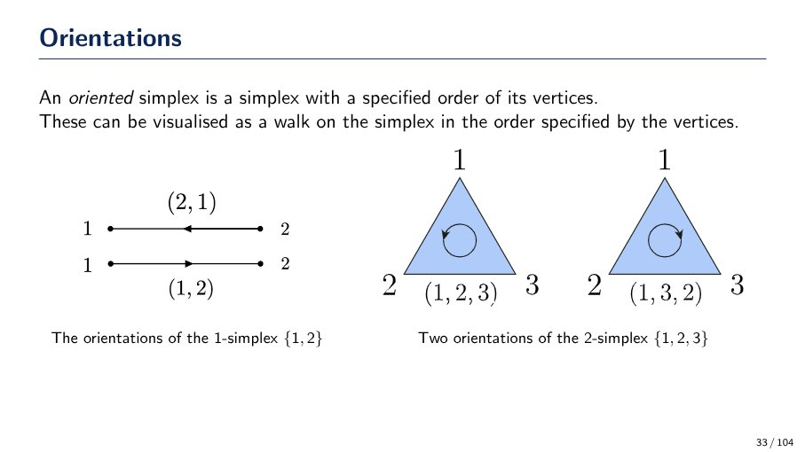
Oriented Simplex Definition and Examples
An oriented simplex is a simplex with a specified order of its vertices. This order can be visualized as a walk on the simplex. For a 1-simplex {1,2}, two orientations are (1,2) and (2,1). For a 2-simplex {1,2,3}, two orientations are (1,2,3) (counter-clockwise walk) and (1,3,2) (clockwise walk).
Source: Page 33

Slide 29
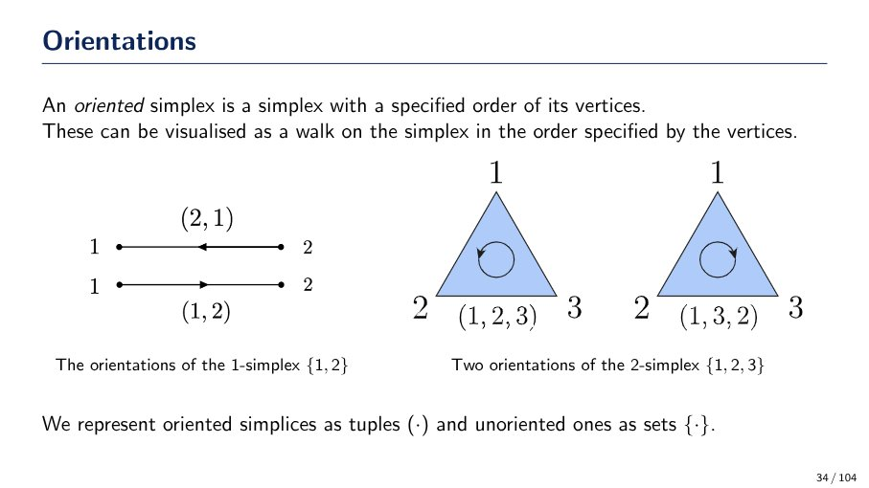
What is an oriented simplex?
An oriented simplex is a simplex with a specified order of its vertices. It can be visualized as a walk on the simplex following the vertex order.
* **Representation:**
* Oriented simplices are represented as tuples (e.g., (1,2) or (1,2,3)).
* Unoriented simplices are represented as sets (e.g., {1,2} or {1,2,3}).
* **Examples:**
* For a 1-simplex {1,2}, orientations include (2,1) and (1,2).
* For a 2-simplex {1,2,3}, orientations include (1,2,3) and (1,3,2).
Source: Page 34

Slide 30
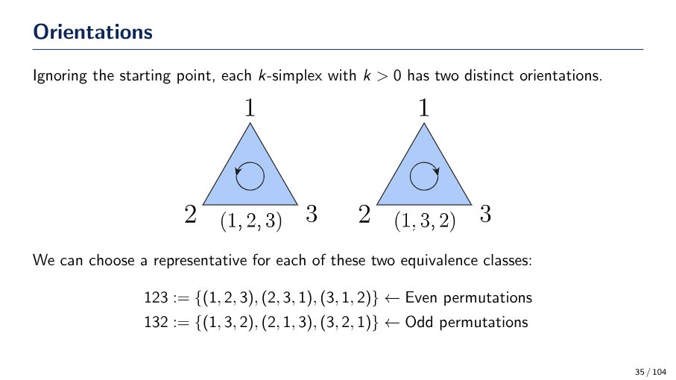
Simplex Orientations and Permutations
For k-simplices (k > 0), there are two distinct orientations. These orientations are defined by equivalence classes of permutations of their vertices. One class corresponds to even permutations (e.g., {(1,2,3), (2,3,1), (3,1,2)} for a triangle), representing one orientation (e.g., counter-clockwise). The other class corresponds to odd permutations (e.g., {(1,3,2), (2,1,3), (3,2,1)}), representing the opposite orientation (e.g., clockwise).
Source: Page 35

Slide 31
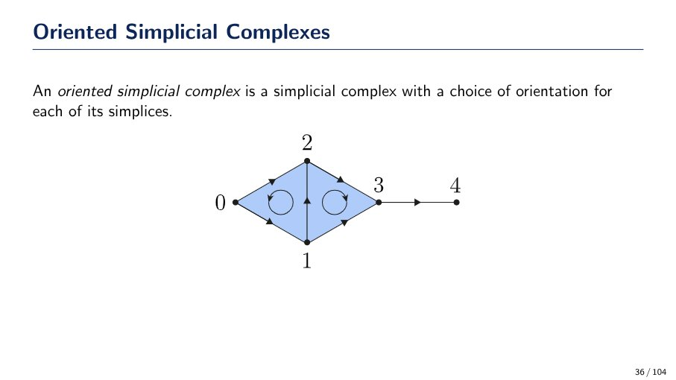
What is an Oriented Simplicial Complex?
An oriented simplicial complex is a simplicial complex where each of its simplices (vertices, edges, faces) has a chosen orientation. The diagram illustrates an example with oriented 2-simplices (triangles) and 1-simplices (edges) between vertices 0, 1, 2, 3, and 4.
Source: Page 36

Slide 32
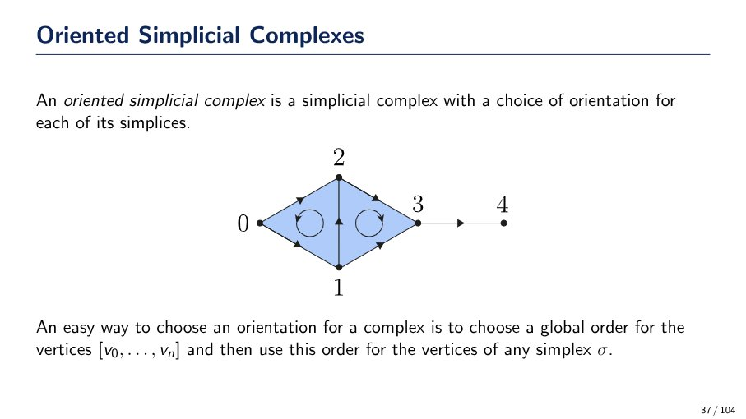
Oriented Simplicial Complexes
An oriented simplicial complex is a simplicial complex with a chosen orientation for each of its simplices. An easy way to choose an orientation is to establish a global order for the vertices `[v0, ..., vn]` and then use this order for the vertices of any simplex `σ`.
Source: Page 37

Slide 33
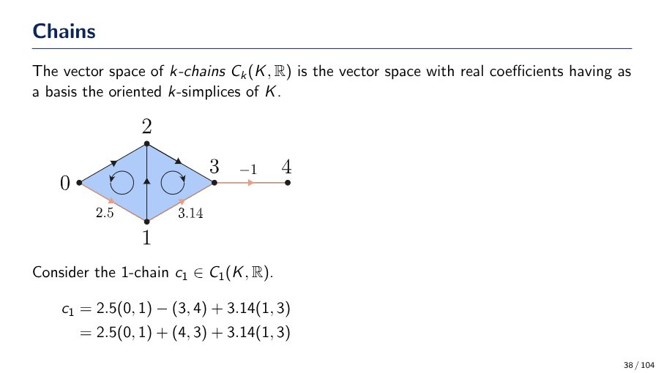
What are k-chains?
A k-chain C_k(K, R) is a vector space with real coefficients, using the oriented k-simplices of K as its basis. For example, a 1-chain c_1 can be expressed as a linear combination of oriented 1-simplices (edges):
c_1 = 2.5(0, 1) - (3, 4) + 3.14(1, 3)
Which is equivalent to:
c_1 = 2.5(0, 1) + (4, 3) + 3.14(1, 3)
Source: Page 38

Slide 34
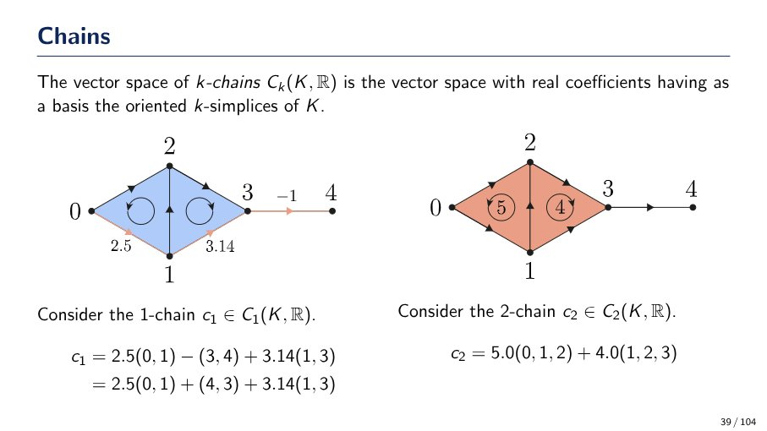
What are k-chains?
A k-chain Ck(K, R) is an element of a vector space with real coefficients, where the basis elements are the oriented k-simplices of K.
* **1-chain (c1)**: A linear combination of oriented edges (1-simplices) with real coefficients. For example, `c1 = 2.5(0, 1) - (3, 4) + 3.14(1, 3)`, which can also be written as `c1 = 2.5(0, 1) + (4, 3) + 3.14(1, 3)`.
* **2-chain (c2)**: A linear combination of oriented triangles (2-simplices) with real coefficients. For example, `c2 = 5.0(0, 1, 2) + 4.0(1, 2, 3)`.
Source: Page 39

Slide 35
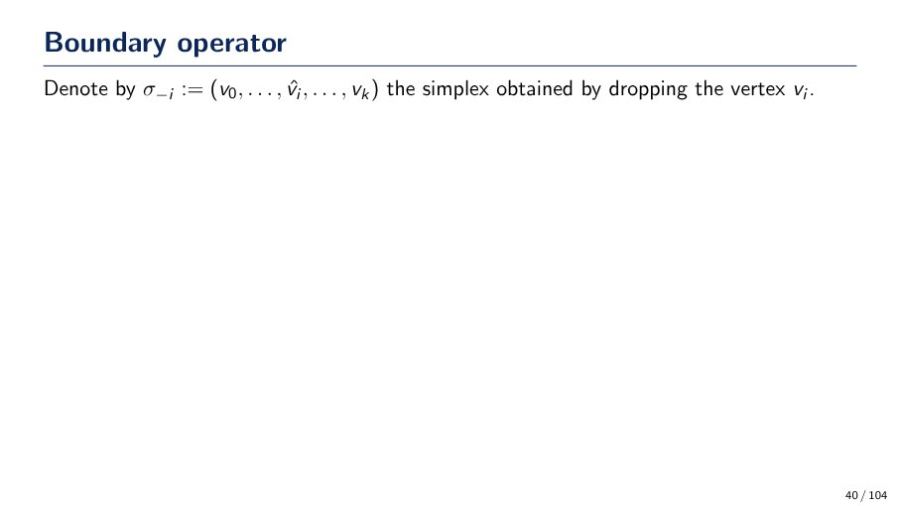
Boundary operator: Simplex notation
The notation $\sigma_{-i} := (v_0, \dots, \hat{v}_i, \dots, v_k)$ denotes a simplex formed by removing the vertex $v_i$ from the original simplex $(v_0, \dots, v_k)$. This is a fundamental concept for defining the boundary operator.
Source: Page 40

Slide 36
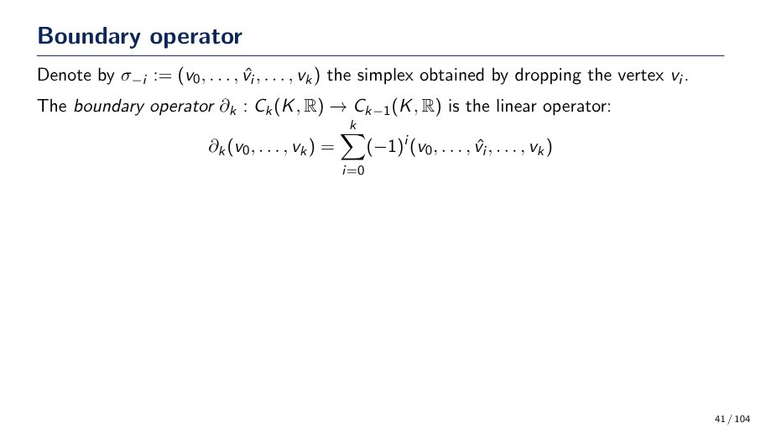
Boundary Operator Definition
The boundary operator, denoted as ∂_k, is a linear operator mapping k-chains to (k-1)-chains: ∂_k : C_k(K, R) → C_{k-1}(K, R). It is defined for a simplex (v_0, ..., v_k) as the alternating sum of its faces: ∂_k(v_0, ..., v_k) = Σ_{i=0}^k (-1)^i (v_0, ..., v_i, ..., v_k), where (v_0, ..., v_i, ..., v_k) represents the simplex obtained by dropping the vertex v_i.
Source: Page 41

Slide 37
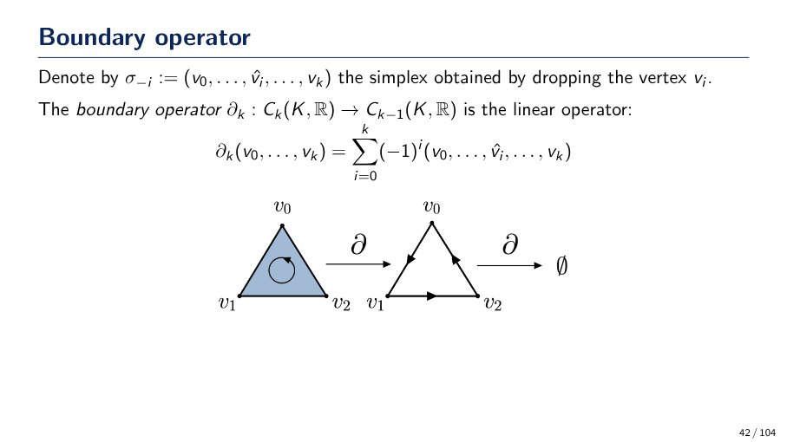
Boundary Operator Definition
The boundary operator `∂_k` is a linear operator mapping `k`-simplices to `(k-1)`-simplices. It is defined as:
`∂_k(v_0, ..., v_k) = Σ_{i=0}^k (-1)^i (v_0, ..., v̂_i, ..., v_k)`
where `(v_0, ..., v̂_i, ..., v_k)` denotes the simplex obtained by dropping vertex `v_i`.
Visually, for a 2-simplex (triangle `v_0v_1v_2`), `∂` maps it to its boundary (the cycle of edges `v_0v_1 + v_1v_2 + v_2v_0`). Applying `∂` again to this boundary results in `∅` (the empty set), illustrating `∂∂ = 0`.
Source: Page 42

Slide 38

Boundary Operator Definition and Application
The boundary operator `∂k` maps k-simplices to (k-1)-simplices. It is defined as a linear operator `∂k : Ck(K, R) → Ck-1(K, R)`. The formula is `∂k(v0, ..., vk) = Σ_{i=0 to k} (-1)^i (v0, ..., ^vi, ..., vk)`, where `(v0, ..., ^vi, ..., vk)` denotes the simplex obtained by dropping vertex `vi`.
For a 2-simplex (triangle) `(v0, v1, v2)`, the boundary is `∂(v0, v1, v2) = (v1, v2) - (v0, v2) + (v0, v1) = (v1, v2) + (v2, v0) + (v0, v1)`. This represents the oriented edges forming the perimeter of the triangle. Applying the boundary operator again to these edges results in the empty set, illustrating the property `∂∂ = 0`.
Source: Page 43

Slide 39
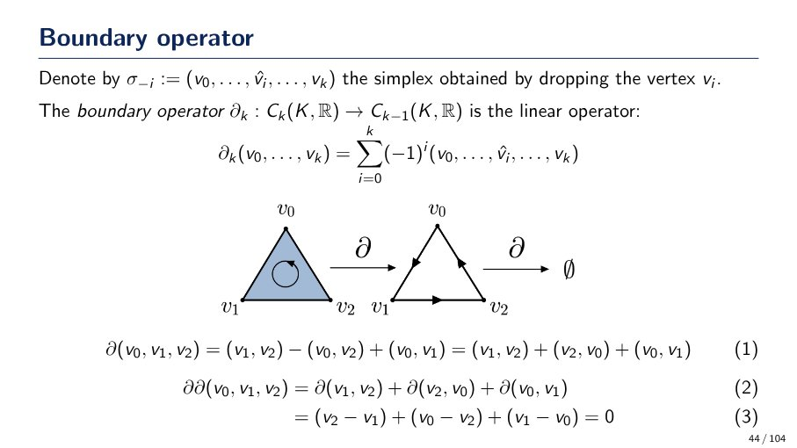
What is the boundary operator in homology?
The boundary operator $\partial_k: C_k(K, \mathbb{R}) \to C_{k-1}(K, \mathbb{R})$ is a linear operator that maps a $k$-simplex to a sum of its $(k-1)$-dimensional faces with alternating signs.
* **Definition:** For a simplex $(v_0, \dots, v_k)$, $\partial_k(v_0, \dots, v_k) = \sum_{i=0}^{k} (-1)^i (v_0, \dots, \hat{v}_i, \dots, v_k)$, where $\hat{v}_i$ means vertex $v_i$ is dropped.
* **Geometric Interpretation:** It transforms a filled simplex (e.g., a triangle) into its boundary (e.g., a cycle of edges).
* **Fundamental Property:** Applying the boundary operator twice always results in zero, i.e., $\partial\partial = 0$. This means the boundary of a boundary is empty.
Source: Page 44

Slide 40
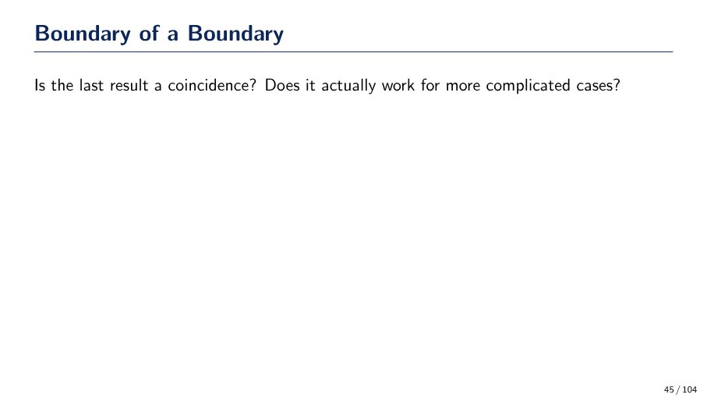
Boundary of a Boundary: Coincidence or General Rule?
This slide poses critical questions regarding the concept of a 'boundary of a boundary': Is a previously observed result a mere coincidence, or does the principle hold true and apply effectively to more intricate and complex cases? This prompts further investigation into the generalizability and robustness of the concept.
Source: Page 45

Slide 41
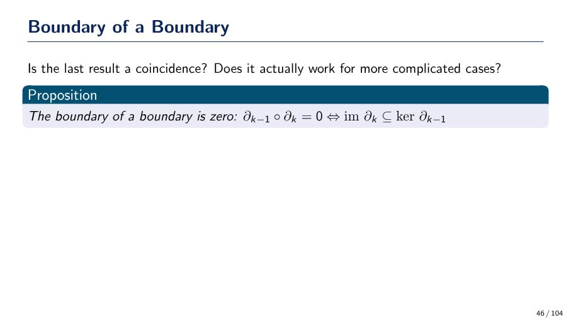
Boundary of a Boundary Theorem
The proposition states that the boundary of a boundary is zero, expressed as $\partial_{k-1} \circ \partial_k = 0$. This condition is equivalent to the image of the k-th boundary operator being a subset of the kernel of the (k-1)-th boundary operator (im $\partial_k \subseteq$ ker $\partial_{k-1}$).
Source: Page 46

Slide 42
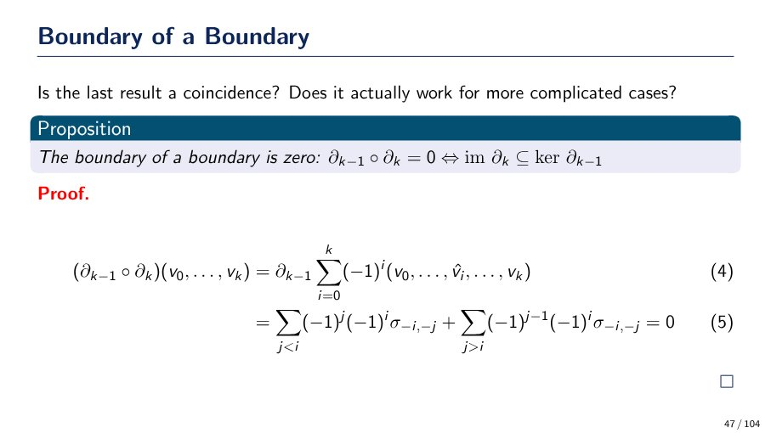
Boundary of a Boundary is Zero
The proposition states that the boundary of a boundary is zero: $\partial_{k-1} \circ \partial_k = 0$. This is equivalent to the image of the k-th boundary operator being a subset of the kernel of the (k-1)-th boundary operator (im $\partial_k \subseteq$ ker $\partial_{k-1}$). The proof begins by applying $\partial_{k-1}$ to the result of $\partial_k$ on a k-simplex $(v_0, \dots, v_k)$, which is defined as a sum of alternating signed (k-1)-simplices (Eq. 4). The subsequent step (Eq. 5) expands this further, showing two sums that are expected to cancel out, thus proving the proposition.
Source: Page 47

Slide 43
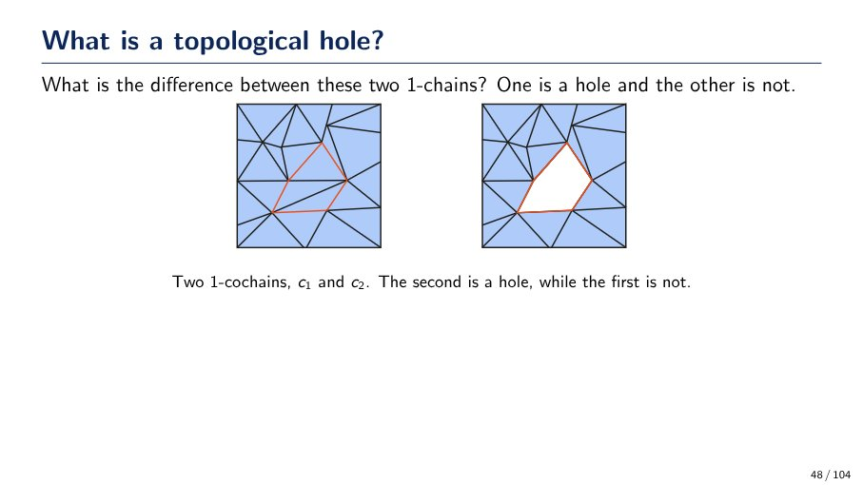
What is a topological hole?
A topological hole is an empty region within a triangulated space, bounded by a 1-cochain (a cycle of edges). The key difference between two 1-cochains (c1 and c2) is whether the region they enclose is filled or empty:
* **c1 (not a hole):** The 1-cochain encloses a region that is filled with triangles.
* **c2 (a hole):** The 1-cochain encloses an empty region.
Source: Page 48

Slide 44
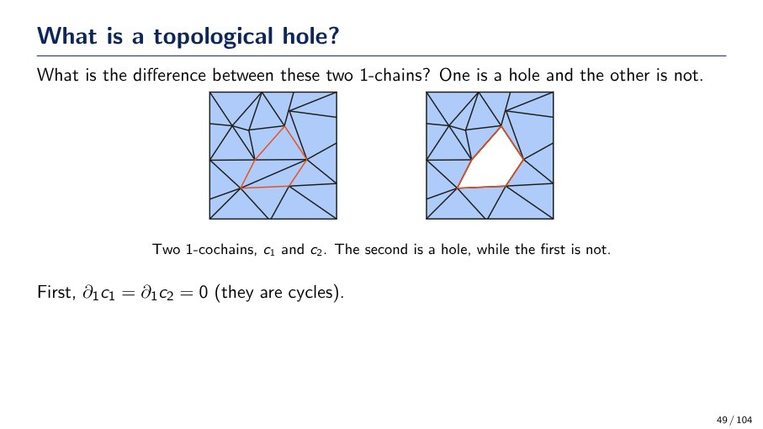
What is a topological hole?
A topological hole is a 1-cycle (a closed loop) that does not bound a 2-chain (a filled region) within the given space. The slide illustrates two 1-cycles:
- **c1 (left):** Not a hole, as the triangular region it encloses is filled (it bounds a 2-chain).
- **c2 (right):** Is a hole, as the pentagonal region it encloses is empty (it does not bound a 2-chain).
Source: Page 49

Slide 45
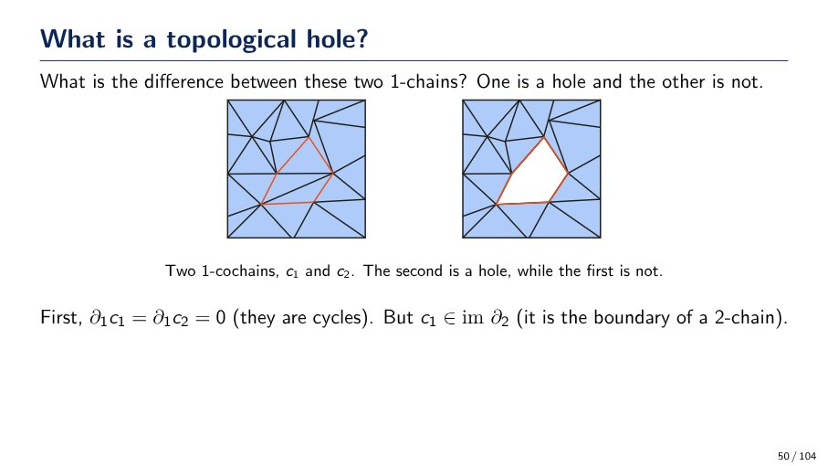
What is a topological hole?
A topological hole is a cycle that is not the boundary of a higher-dimensional chain.
* Both `c1` and `c2` are 1-cycles (∂₁c₁ = ∂₁c₂ = 0).
* `c1` (not a hole) is the boundary of a 2-chain (c₁ ∈ im ∂₂), meaning the enclosed region is 'filled'.
* `c2` (a hole) is a cycle but *not* the boundary of a 2-chain, meaning the enclosed region is 'empty'.
Source: Page 50

Slide 46
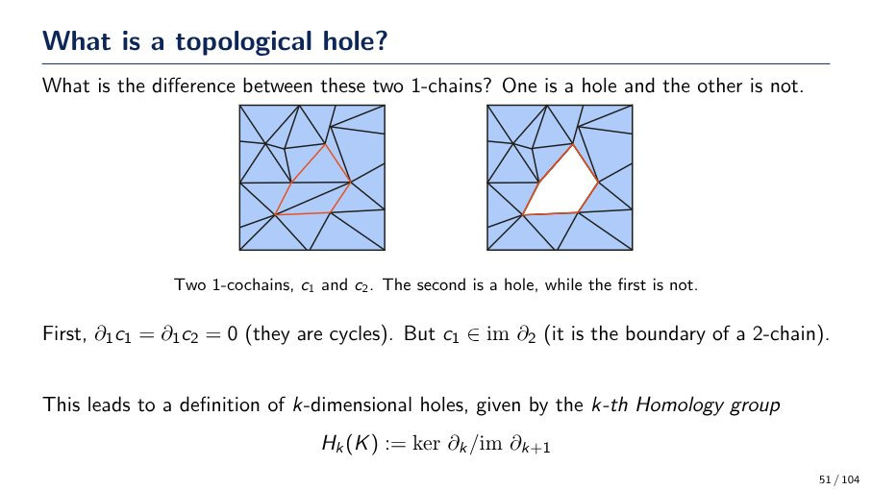
What is a topological hole?
A topological hole is a cycle that does not bound a higher-dimensional chain. For two 1-chains, c1 and c2:
- Both are cycles (∂1c1 = ∂1c2 = 0).
- c1 is *not* a hole because it is the boundary of a 2-chain (c1 ∈ im ∂2).
- c2 *is* a hole because it is a cycle but does *not* bound a 2-chain.
This concept is formalized by the k-th Homology group: Hk(K) := ker ∂k / im ∂k+1, where ker ∂k represents k-cycles and im ∂k+1 represents k-boundaries.
Source: Page 51

Slide 47
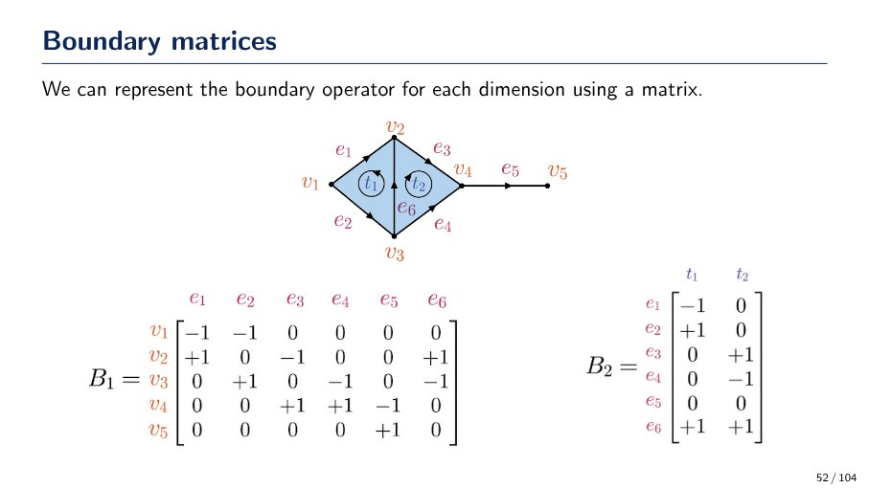
Boundary matrices in simplicial complexes
Boundary matrices represent boundary operators, mapping k-simplices to (k-1)-simplices. For a given simplicial complex:
- **B_1 (vertex-edge matrix)**: Rows correspond to vertices, columns to edges. An entry is +1 if the vertex is the head of the edge, -1 if the tail, and 0 otherwise.
- **B_2 (edge-face matrix)**: Rows correspond to edges, columns to faces. An entry is +1 if the edge is part of the face boundary with consistent orientation, -1 if inconsistent, and 0 otherwise.
The slide provides examples of B_1 for vertices v1-v5 and edges e1-e6, and B_2 for edges e1-e6 and faces t1-t2.
Source: Page 52

Slide 48
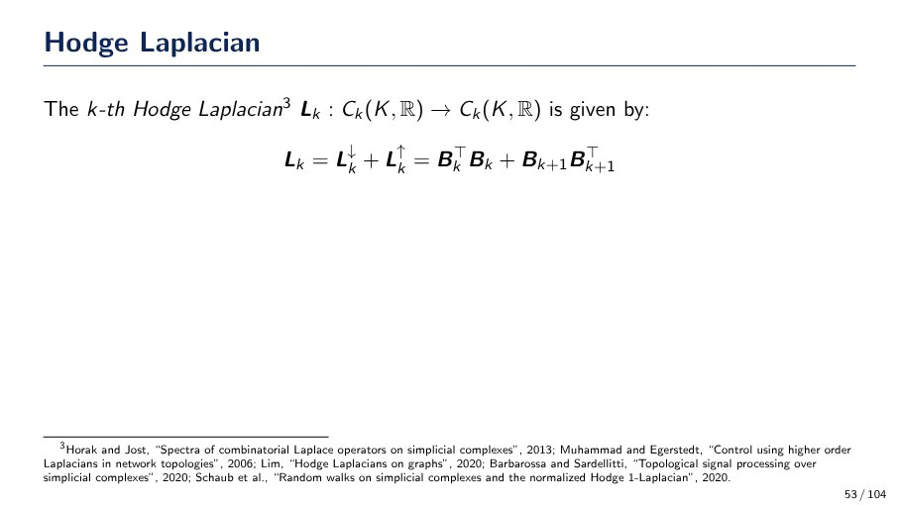
What is the k-th Hodge Laplacian?
The k-th Hodge Laplacian, denoted L_k, is an operator mapping C_k(K, R) to C_k(K, R). It is defined as the sum of the 'down' and 'up' Laplacians: L_k = L_k^down + L_k^up. The specific formula for L_k is given by L_k = B_k^T B_k + B_{k+1} B_{k+1}^T, where B_k and B_{k+1} are boundary operators. This concept is fundamental in areas like combinatorial Laplace operators and topological signal processing on simplicial complexes.
Source: Page 53

Slide 49
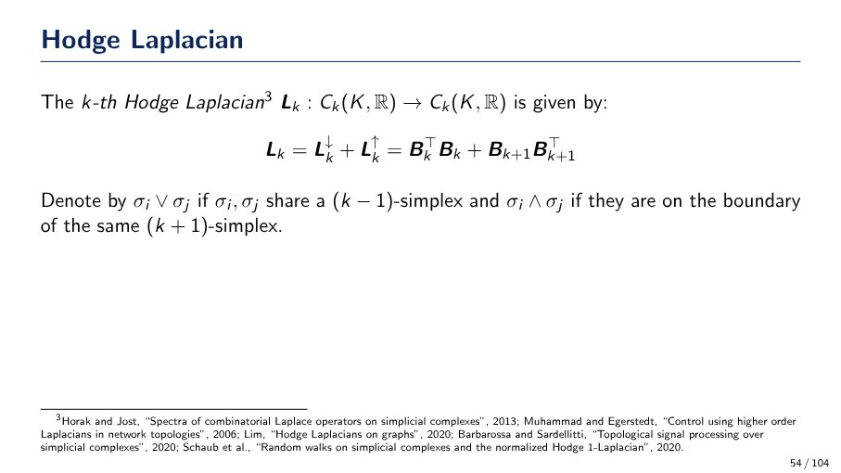
Hodge Laplacian Definition
The k-th Hodge Laplacian, denoted as $L_k$, is a linear operator mapping from $C_k(K, \mathbb{R})$ to $C_k(K, \mathbb{R})$. It is defined by the formula:
$L_k = L_k^{\downarrow} + L_k^{\uparrow} = B_k^T B_k + B_{k+1} B_{k+1}^T$
Additionally, the notation $\sigma_i \lor \sigma_j$ indicates that $\sigma_i$ and $\sigma_j$ share a $(k-1)$-simplex. The notation $\sigma_i \land \sigma_j$ indicates that $\sigma_i$ and $\sigma_j$ are on the boundary of the same $(k+1)$-simplex.
Source: Page 54

Slide 50
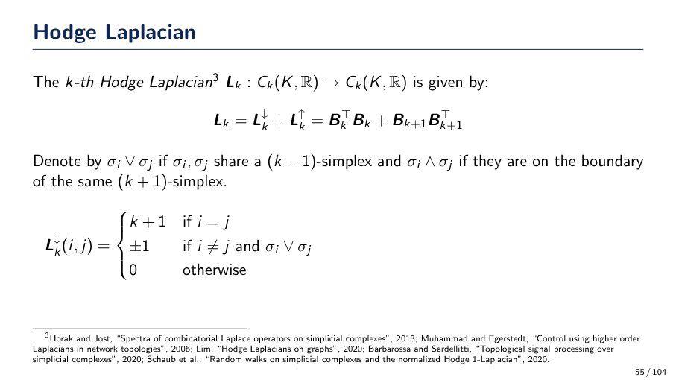
Hodge Laplacian definition
The k-th Hodge Laplacian $L_k: C_k(K,\mathbb{R}) \to C_k(K,\mathbb{R})$ is defined as:
$L_k = L_k^\downarrow + L_k^\uparrow = B_k^T B_k + B_{k+1} B_{k+1}^T$
Where $L_k^\downarrow(i,j)$ is a piecewise function:
- $k+1$ if $i=j$
- $\pm 1$ if $i \neq j$ and $\sigma_i \lor \sigma_j$
- $0$ otherwise
**Notation:**
- $\sigma_i \lor \sigma_j$: $\sigma_i, \sigma_j$ share a $(k-1)$-simplex.
- $\sigma_i \land \sigma_j$: $\sigma_i, \sigma_j$ are on the boundary of the same $(k+1)$-simplex.
Source: Page 55

Slide 51
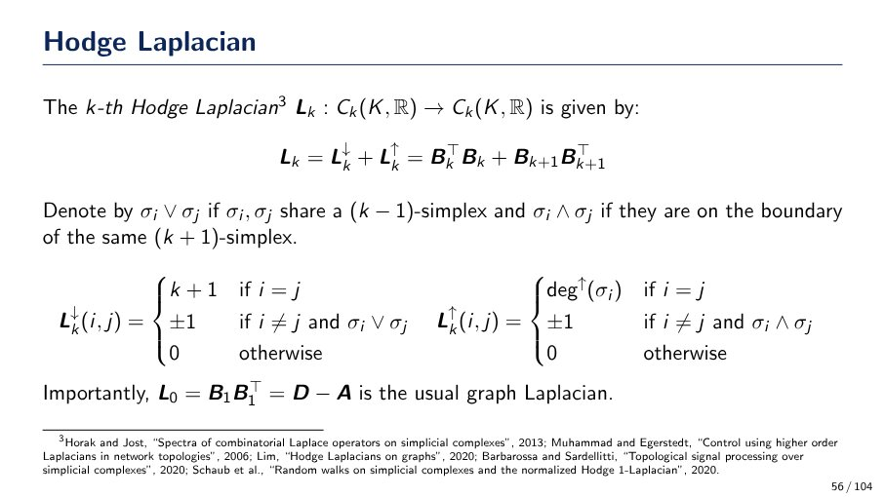
What is the k-th Hodge Laplacian?
The k-th Hodge Laplacian, `L_k`, is defined as `L_k = L_k^down + L_k^up = B_k^T B_k + B_{k+1} B_{k+1}^T`. Its matrix elements `L_k^down(i,j)` are:
* `k+1` if `i=j`
* `+/-1` if `i!=j` and `sigma_i, sigma_j` share a `(k-1)`-simplex (`sigma_i V sigma_j`)
* `0` otherwise
And `L_k^up(i,j)` are:
* `deg^up(sigma_i)` if `i=j`
* `+/-1` if `i!=j` and `sigma_i, sigma_j` are on the boundary of the same `(k+1)`-simplex (`sigma_i ^ sigma_j`)
* `0` otherwise
Importantly, `L_0` is equivalent to the usual graph Laplacian, `D - A`.
Source: Page 56

Slide 52
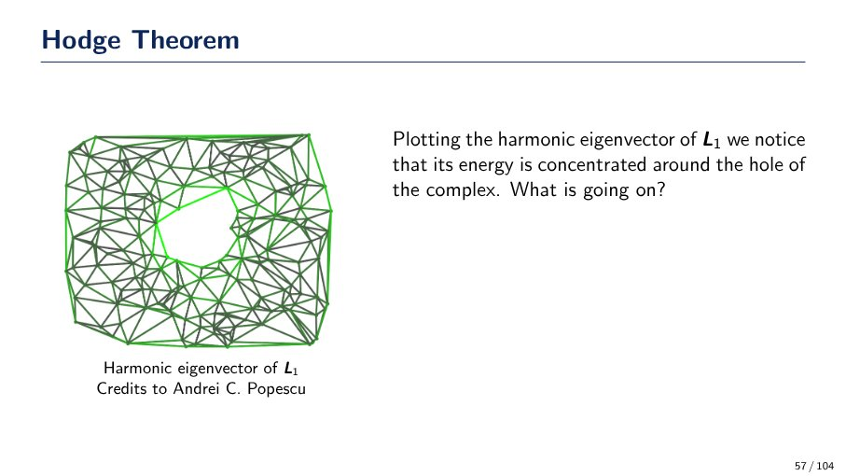
Harmonic eigenvector energy concentration
Plotting the harmonic eigenvector of L1 reveals that its energy is concentrated around the hole of the complex. This observation prompts the question: 'What is going on?', suggesting a deeper mathematical or topological explanation for this phenomenon.
Source: Page 57

Slide 53

Hodge Theorem & Harmonic Eigenvectors
The Hodge Theorem states that the kernel of the Laplacian operator Lk (ker Lk) and the k-th homology group Hk(K) are isomorphic vector spaces. This means harmonic eigenvectors (like the one shown for L1) can detect topological features such as holes in a complex, as their energy concentrates around these features.
Source: Page 58

Slide 54

Hodge Theorem & Betti Numbers
The Hodge Theorem states that the kernel of the Laplacian operator (ker Lk) and the k-th homology group (Hk(K)) are isomorphic vector spaces. This means the k-th Betti number (βk), defined as βk = dim(ker Lk) = dim(Hk), counts the number of k-dimensional holes in a complex. For instance, the harmonic eigenvector of L1 concentrates energy around a 1-dimensional hole.
Source: Page 59

Slide 55

Simplicial Convolutional Networks: Core Definitions
Simplicial Convolutional Networks are defined using:
- **Simplicial complex K**: The fundamental structure.
- **Normalised Hodge Laplacian Δ_k**: Expressed as Δ_k = αL_k, where L_k is the Hodge Laplacian and α > 0. This operator is essential for defining convolutions.
- **k-simplex features X**: Features associated with each k-simplex, represented by a matrix X ∈ R^(n_k × d), where n_k is the number of k-simplices and d is the feature dimension.
Source: Page 60

Slide 56

Simplicial Convolutional Networks (SCN)
SCNs extend Graph Convolutional Networks (GCNs) to simplicial complexes. Given:
- A simplicial complex $K$ with a normalized Hodge Laplacian $\Delta_k = \alpha L_k$ (where $\alpha > 0$).
- $k$-simplex features $X \in \mathbb{R}^{n_k \times d}$.
The simplicial equivalent of a GCN layer is defined as:
$Y := \sigma((I - \Delta_0)XW)$
where:
- $Y$ is the output feature matrix.
- $\sigma$ is an activation function.
- $I$ is the identity matrix.
- $\Delta_0$ is the 0-th order Hodge Laplacian.
- $X$ represents the input features.
- $W$ is a learnable weight matrix.
Source: Page 61

Slide 57

Simplicial CNNs: Convergence Theorem
- **Model**: Simplicial equivalent of GCN, Y := σ((I - Δ0)XW), where Δk = αLk is the normalised Hodge Laplacian.
- **Key Definitions**: λ* = maxλi≠0(1 - λi)^2 (based on eigenvalues λi of Δk), σ = id (identity activation), and Dirichlet energy E(X) = trace(X^T Δk X).
- **Theorem**: E(Y) ≤ λ* ||W^T||^2 E(X).
- **Convergence**: If α (scaling factor for Laplacian) is sufficiently low, the model converges exponentially fast to the kernel of Δk.
Source: Page 62

Slide 58

Deep Linear GCNs: Asymptotic Behavior
The asymptotic behavior of Deep Linear Graph Convolutional Networks (GCNs) and their simplicial version is topological. This means that the features converge to a signal depending only on the connected components of the graph and their respective node degrees.
Source: Page 63

Slide 59

Topological Asymptotic Behavior of Linear GCNs and Simplicial CNs
The asymptotic behavior of Deep Linear GCNs and their simplicial versions is topological. Specifically:
- **(Linear) GCN:** Features converge to a signal that depends only on the connected components of the graph and their degrees.
- **Linear Simplicial CN:** Features converge to a signal whose energy is concentrated around the holes of the complex.
Source: Page 64

Slide 60

Topological implications of GCN and Simplicial CN asymptotic behavior
The asymptotic behavior of Deep Linear GCNs and their simplicial versions is topological:
- **(Linear) GCNs**: Features converge to a signal dependent on the graph's connected components and their degrees.
- **Linear Simplicial CNs**: Features converge to a signal with energy concentrated around the holes of the complex.
- The dimension of the subspace where the model converges remains invariant under homeomorphisms, as $\beta_k$ (Betti number) is a topological invariant.
Source: Page 65

Slide 61

Hodge Decomposition of a Chain
The Hodge Decomposition Theorem states that a chain `C_k(K, R)` can be uniquely decomposed into three orthogonal components:
* **Rotational part**: `im ∂_k^T` (e.g., `im ∂_2` in the diagram, characterized by swirling patterns).
* **Harmonic part**: `ker L_k` (e.g., `ker L_1` in the diagram, representing smooth, non-rotational, non-gradient flow).
* **Gradient part**: `im ∂_{k+1}` (e.g., `im ∂_1^T` in the diagram, showing flow originating from sources and ending at sinks).
This decomposition is illustrated on a torus, breaking down a complex flow into these fundamental parts.
Source: Page 66

Slide 62

Simplicial Convolutions: Definition & Mechanism
Simplicial convolutions are defined using a Laplacian. All such convolutions can be understood as a form of message passing. This concept is explored in various research, including works on Simplicial Neural Networks, Simplicial 2-Complex Convolutional Neural Networks, and Simplicial Attention Networks.
Source: Page 67

Slide 63

Simplicial Convolutional Network (SCN) Structure
SCNs define convolutions using a Laplacian, seen as message passing. Key components:
- **Inputs**: X0, X1, X2 are matrices for 0, 1, and 2-chains respectively.
- **Weights**: W_i are learnable parameters.
- **Operators**: L_down, L_up, B_transpose, B_2 (representing lower/upper adjacency, boundary/coboundary) can be replaced by attention matrices.
- **Output (Y)**: Y = psi(L_down X1 W1 + L_up X1 W2 + B_transpose X0 W3 + B2 X2 W4 + X1 W5), combining different simplicial operations (lower/upper adjacency, boundary/coboundary) on various chain inputs with learned weights.
Source: Page 68

Slide 64

Simplicial Convolutional Network (SCN) Architecture
SCNs define convolutions using a Laplacian, interpretable as message passing. Input features $X_0, X_1, X_2$ represent 0, 1, and 2-chains, respectively. The output $Y$ is computed as $Y = \psi(L_1^\downarrow X_1 W_1 + L_1^\uparrow X_1 W_2 + B_1^T X_0 W_3 + B_2 X_2 W_4 + X_1 W_5)$, where $L_1^\downarrow$, $L_1^\uparrow$, $B_1^T$, and $B_2$ are lower adjacency, upper adjacency, boundary adjacency, and coboundary adjacency operators. These operators can be replaced by matrices with the same sparsity pattern (e.g., attention matrices). This factorization is linked to the Hodge decomposition.
Source: Page 69

Slide 65

Permutation Equivariance in Simplicial Complexes
A simplicial complex of dimension `d` is defined by its boundary matrices `B = (B1, ..., Bd)`. A tuple of permutation matrices is `P = (P0, ..., Pd)`. The action of `P` on `B` is denoted as `PB = (P0 B1 P1^T, ..., Pd-1 Bd Pd^T)`.
Source: Page 70

Slide 66

Permutation Equivariance Proposition
Permutation equivariance for functions on simplicial complexes is defined. A simplicial complex B is specified by boundary matrices (B_1, ..., B_d). A tuple of permutation matrices P = (P_0, ..., P_d) transforms B to PB = (P_0 B_1 P_1^T, ..., P_{d-1} B_d P_d^T). A function f: C_k(K, R)^{F_1} -> C_k(K, R)^{F_2} is permutation equivariant if f(PB, P_k X) = P_k f(B, X). A proposition states that the function f(B, X) := ψ(L_1^↓ X_1 W_1 + L_1^↑ X_1 W_2) is permutation equivariant. A proof sketch for lower adjacencies demonstrates this with the identity (P_0 B_1 P_1^T)^T (P_0 B_1 P_1^T) (P_1 X_1) W_1 = P_1 B_1^T B_1 X_1 W.
Source: Page 71

Slide 67

Permutation Equivariance of f(B, X)
A function `f: Ck(K,R)^F1 \to Ck(K,R)^F2` is permutation equivariant if `f(PB, PkX) = Pk f(B, X)`.
* `B = (B1, ..., Bd)` represents a simplicial complex via its boundary matrices.
* `PB = (P0B1P1^T, ..., Pd-1BdPd^T)` is the permuted version of `B`, where `P = (P0, ..., Pd)` are permutation matrices.
* **Proposition:** The function `f(B, X) := \psi(L_1^{\downarrow}X_1W_1 + L_1^{\uparrow}X_1W_2)` is permutation equivariant.
* **Proof Sketch:** The proof demonstrates that applying permutations to `B` and `X` results in the permutation matrix `Pk` factoring out. For instance, considering lower adjacencies, `(P_0B_1P_1^T)^T (P_0B_1P_1^T) (P_1X_1)W_1` simplifies to `P_1(L_1^{\downarrow}X_1W)`.
Source: Page 72

Slide 68

Proposition: Permutation Equivariance of f(B, X)
A simplicial complex B is defined by boundary matrices (B_1, ..., B_d). A tuple of permutation matrices P = (P_0, ..., P_d) transforms B to PB = (P_0 B_1 P_1^T, ..., P_{d-1} B_d P_d^T). A function f is permutation equivariant if f(PB, P_k X) = P_k f(B, X).
**Proposition:** The function f(B, X) := \psi(L_1^\downarrow X_1 W_1 + L_1^\uparrow X_1 W_2) is permutation equivariant.
**Proof Sketch:**
* For lower adjacencies: (P_0 B_1 P_1^T)^T (P_0 B_1 P_1^T) (P_1 X_1) W_1 = P_1 B_1^T B_1 X_1 W = P_1 (L_1^\downarrow X_1 W).
* Upper adjacencies proceed similarly.
* The nonlinearity \psi commutes with P_1.
Source: Page 73

Slide 69

What is orientation equivariance and its implication for function f?
Orientation equivariance implies that a model's output should change predictably (e.g., by a sign flip) when the input's orientation is reversed. This is illustrated by a commutative diagram:
* **Top Path:** An input `3` (with orientation `v1 -> v2`) is transformed by `f` to `f(3)`. Applying an orientation change `σ` to the input `3` results in `-3` (with orientation `v2 -> v1`).
* **Bottom Path:** The output `f(3)` (with orientation `v1 -> v2`) is transformed by `σ` to `-f(3)` (with orientation `v2 -> v1`).
For the system to be orientation equivariant, the result of applying `f` then `σ` must be the same as applying `σ` then `f`. This means:
`σ(f(3)) = f(σ(3))`
From the diagram, `σ(3) = -3` and `σ(f(3)) = -f(3)`. Therefore, for orientation equivariance, the function `f` must satisfy:
`-f(3) = f(-3)`
This is the definition of an **odd function** (`f(-x) = -f(x)`).
Source: Page 74

Slide 70

Orientation Equivariance in Boundary Matrices
If a simplex changes its orientation, it flips its relative orientation with respect to adjacent neighbors. This is reflected by flipping signs in the corresponding rows and columns of boundary matrices.
For example, if a 2-simplex (triangle `t2`) flips its orientation:
- The column corresponding to `t2` in the `B2` matrix (mapping 2-simplices to 1-simplices) has all its signs flipped.
- The shared 1-simplex (edge `e6`) also effectively flips its orientation.
- This flip in `e6`'s orientation causes:
- The column corresponding to `e6` in the `B1` matrix (mapping 1-simplices to 0-simplices) to have its signs flipped.
- The entry for `e6` in the boundary of the adjacent 2-simplex (`t1`) in the `B2` matrix to have its sign flipped.
Source: Page 75

Slide 71

Orientation Equivariance: Matrix Tuple T and Transformation TB
In the context of Orientation Equivariance:
- A tuple of matrices `T` is defined as `(T_0, ..., T_d)`.
- Each `T_i` is a diagonal matrix with values from `{+1, -1}`.
- `T_0` is restricted to be the identity matrix (`I`) because vertices always have a positive orientation.
- The transformation `TB` is denoted as `(T_0 B_1 T_1, ..., T_{d-1} B_d T_d)`.
Source: Page 76

Slide 72

Orientation Equivariance
A function `f: Ck(K,R)F¹ → Ck(K,R)F²` is orientation equivariant if `f(TB, TkX) = Tkf(B, X)`, where `T = (T₀, ..., Td)` is a tuple of diagonal matrices with `{\pm 1}` values (`T₀ = I`), and `TB = (T₀B₁T₁, ..., Td-₁BdTd)`.
**Proposition:** The function `f(B, X) := ψ(L₁↓X₁W₁ + L₁↑X₁W₂)` is orientation equivariant when `ψ` is an odd function.
**Proof Sketch:** The proof involves demonstrating that `ψ(((T₀B₁T₁)^T (T₀B₁T₁))T₁X₁W)` simplifies to `ψ(T₁L₁↓X₁W)`, utilizing the property that an odd function `ψ` commutes with `T₁`.
Source: Page 77

Slide 73

Orientation Equivariance Condition
A function $f: C_k(K, \mathbb{R})^{F_1} \to C_k(K, \mathbb{R})^{F_2}$ is orientation equivariant if $f(\mathcal{T}\mathcal{B}, \mathbf{T}_k\mathbf{X}) = \mathbf{T}_k f(\mathcal{B}, \mathbf{X})$. Here, $\mathcal{T} = (\mathbf{T}_0, \dots, \mathbf{T}_d)$ where each $\mathbf{T}_i$ is a diagonal matrix with $\pm 1$ entries and $\mathbf{T}_0 = \mathbf{I}$. The transformed incidence matrices are $\mathcal{T}\mathcal{B} = (\mathbf{T}_0\mathbf{B}_1\mathbf{T}_1, \dots, \mathbf{T}_{d-1}\mathbf{B}_d\mathbf{T}_d)$.
**Proposition:** The function $f(\mathcal{B}, \mathcal{X}) := \psi(\mathbf{L}_1^\downarrow\mathbf{X}_1\mathbf{W}_1 + \mathbf{L}_1^\uparrow\mathbf{X}_1\mathbf{W}_2)$ is orientation equivariant when $\psi$ is an odd function. This is because an odd $\psi$ commutes with $\mathbf{T}_1$, allowing $\mathbf{T}_1$ to be factored out. This principle generalizes to simplicial message passing architectures.
Source: Page 78

Slide 74

Convolution on Chain Complexes
A chain complex is a sequence of vector spaces (e.g., `C_k(K,R)`) connected by boundary maps (`∂_k`). Convolutions can be applied to these complexes, with boundary matrices ensuring communication across different dimensions. The output `Y` is calculated using the formula: `Y = ψ(L_1↓ X_1 W_1 + L_1↑ X_1 W_2 + B_1ᵀ X_0 W_3 + B_2 X_2 W_4 + X_1 W_5)`, where `ψ` is an activation function, `L` denotes Laplacians (down/up), `B` represents boundary matrices, `X` are input features, and `W` are learnable weights.
Source: Page 80

Slide 75

Chain Complex Convolution and Non-linearity
Convolutions operate on chain complexes, which are sequences of vector spaces connected by boundary maps. Boundary matrices facilitate communication between different dimensions within the chain. The convolution operation is defined by the formula: Y = \psi(L_1\downarrow X_1W_1 + L_1\uparrow X_1W_2 + B_1^\top X_0W_3 + B_2X_2W_4 + X_1W_5). A key proposition states that the activation function \psi must be non-linear for simplices that are more than two dimensions apart to communicate effectively.
Source: Page 81

Slide 76

Why is non-linearity crucial in chain complex convolutions?
Convolutions on chain complexes use boundary maps to ensure communication across different dimensions. The output `Y` is computed as `Y = ψ(L_1↓ X_1 W_1 + L_1↑ X_1 W_2 + B_1^T X_0 W_3 + B_2 X_2 W_4 + X_1 W_5)`. A key proposition states that `ψ` must be non-linear for simplices more than two dimensions apart to communicate. If `ψ` were the identity (linear), 2-chains propagating to the 0-chain level would result in `B_1(B_2 X_2 W_4^1)W_4^2 = (B_1 B_2)X_2 W_4^1 = 0`, due to the property `B_1 B_2 = 0` in chain complexes, thus preventing communication.
Source: Page 82

Slide 77

Trajectory Classification Performance
This slide details the application of various methods (GNN L0-inv, MPSN L0-inv, MPSN - ReLU, MPSN - Id, MPSN - Tanh) to trajectory classification. Trajectories are represented as 1-chains, with edge orientations fixed during training and randomly flipped during testing.
Two tasks are evaluated:
- **Synthetic Flow**: Classifying random walks.
- MPSN - ReLU achieves 100.0% on train, but 50.0% on test.
- MPSN - Tanh shows the best test performance at 95.2% ± 1.8.
- **Ocean Drifters**: Classifying trajectories around Madagascar.
- MPSN - Id achieves the highest train accuracy at 94.6% ± 0.9.
- MPSN L0-inv achieves the best test performance at 71.5% ± 4.1.
Overall, MPSN variants generally outperform GNN L0-inv, with different MPSN architectures excelling in specific tasks or metrics.
Source: Page 83

Slide 78

Why Cell Complexes?
Cell complexes are introduced because the subset inclusion property of simplicial complexes can be restrictive. They allow us to still exploit the valuable topological tools that come with such structures, despite the limitations of simplicial complexes.
Source: Page 85

Slide 79

Cell Complex Definition
A finite (regular) cell complex is a topological space X formed by a finite disjoint union of subspaces called cells. These cells must satisfy two conditions: 1. Each cell is homeomorphic to R^n for some n. 2. The closure of each cell is homeomorphic to a closed ball in R^n. This structure allows for the use of topological tools while being less restrictive than simplicial complexes, as illustrated by homeomorphisms (φ1, φ2, φ3) mapping closed balls to cells of varying dimensions within the complex.
Source: Page 86

Slide 80

Hierarchical Construction of Cell Complexes
Cell complexes are constructed hierarchically through these steps:
1. **Start:** Begin with a set of vertices.
2. **Add 1D elements:** Glue the boundary of a set of line segments to these existing vertices.
3. **Add 2D elements:** Glue the boundary of two-dimensional disks to the cycles formed in the graph from the previous step.
Source: Page 87

Slide 81

Weisfeiler Lehman Test
The Weisfeiler Lehman (WL) test is a heuristic algorithm for testing graph isomorphism. It works by:
- Performing iterative colour-refinement: Nodes are initially assigned a color, then iteratively re-colored based on their current color and the multiset of colors of their neighbors.
- Generating a 'HASH' (a multiset of node colors) at each step.
- Comparing the final color histograms (distributions) of two graphs after convergence.
**Limitation:** If two non-isomorphic graphs converge to the same color histogram, the WL test is inconclusive and fails to distinguish them.
Source: Page 88

Slide 82

CWL Edge Color Refinement
The Cellular Weisfeiler-Lehman (CWL) test generalizes the WL algorithm for graphs to cellular complexes. For an edge, a color refinement step involves computing a `HASH` function that incorporates:
- The edge's current color.
- Its `Boundary`: colors of its incident 0-cells (vertices).
- Its `Coboundary`: colors of the higher-dimensional cells (e.g., 2-cells/triangles) it is part of.
- Its `Upper adjacency`: colors of adjacent higher-dimensional cells.
- Its `Lower adjacency`: colors of adjacent lower-dimensional cells.
This iterative process is applied to all cells in the complex until colors converge.
Source: Page 89

Slide 83

Expressive Power of CWL
The slide defines `k-CL`, `k-IC`, and `k-C` as "lifting" maps that attach cells to cliques, induced cycles, and simple cycles (respectively) of size at most `k`. A theorem states that for `k ">= 3`, `CWL(k-CL)`, `CWL(k-IC)`, and `CWL(k-C)` are *strictly more powerful* than the standard WL algorithm. The visual examples demonstrate pairs of graphs that WL cannot distinguish, but CWL can.
Source: Page 90

Slide 84

Sparse Adjacencies in Star Graphs
Considering all adjacencies can lead to exploding computational complexity. Even though a star graph is sparse, all its edges are "lower adjacent" to each other (sharing the central node), enabling them to exchange messages.
Source: Page 91

Slide 85

Sparse Adjacencies and CWL Expressiveness
Considering all adjacencies can lead to computational complexity explosion. Even sparse graphs, like a star graph, have edges that are 'lower adjacent' and exchange messages. A key theorem states that CWL (Cellular Weisfeiler-Leman) without coboundary and using only lower adjacencies is as expressive as CWL with the full set of adjacencies, suggesting that full adjacency information may not always be necessary for expressiveness.
Source: Page 92

Slide 86

Topological Message Passing: Message Types
In Topological Message Passing, cells receive two types of messages:
- **Boundary Messages (orange arrows):** Received by cells like σ and τ.
- Equation: `m_B^(t+1)(σ) = AGG_τ∈B(σ) (M_B(h_σ^t, h_τ^t))`
- **Upper Messages (blue arrows):** Received by cells like τ and δ.
- Equation: `m_↑^(t+1)(σ) = AGG_τ∈N_↑(σ), δ∈C(σ,τ) (M_↑(h_σ^t, h_τ^t, h_δ^t))`
Source: Page 93

Slide 87

Topological Message Passing Mechanism
Topological Message Passing involves cells exchanging and aggregating information based on their topological relationships. Cells receive two types of messages:
* **Boundary Messages (`m_B^{t+1}(\sigma)`):** Aggregated from cells `\tau` in the boundary `B(\sigma)`, using a message function `M_B(h_\sigma^t, h_\tau^t)`. (Indicated by orange arrows).
* **Upper Messages (`m_\uparrow^{t+1}(\sigma)`):** Aggregated from cells `\tau` in `N_\uparrow(\sigma)` and `\delta` in `C(\sigma,\tau)`, using a message function `M_\uparrow(h_\sigma^t, h_\tau^t, h_\delta^t)`. (Indicated by blue arrows).
The cell's state is updated using an update function `U` that takes the current state `h_\sigma^t` and the aggregated boundary and upper messages as input: `h_\sigma^{t+1} = U(h_\sigma^t, m_B(\sigma), m_\uparrow^{t+1}(\sigma))`.
Source: Page 94

Slide 88

Topological Message Passing Mechanism
Topological Message Passing involves cells receiving two types of messages:
* **Boundary messages** ($m_B^{t+1}(\sigma)$): Aggregated from cells $\tau$ in the boundary of $\sigma$.
* **Upper messages** ($m_{\uparrow}^{t+1}(\sigma)$): Aggregated from cells $\tau$ in the upper neighborhood of $\sigma$ and cells $\delta$ in the co-boundary of $\sigma$ and $\tau$.
These messages, along with the current state ($h_{\sigma}^t$), are used by an **update function** $U$ to compute the next state ($h_{\sigma}^{t+1}$). A **readout function** then computes a final representation from the cell states across different dimensions.
Source: Page 95

Slide 89

Topological Message Passing Expressive Power Theorem
Topological message passing, when implemented with injective neighborhood aggregators and a sufficient number of layers, achieves the same expressive power as CWL.
Source: Page 96

Slide 90

Expressive Power of Topological Message Passing
A theorem states that topological message passing, when utilizing injective neighborhood aggregators and a sufficient number of layers, achieves expressive power equivalent to that of CWL (e.g., 3WL).
The accompanying bar chart provides empirical evidence, comparing the failure rates of MLP sum (with 4, 5, and 6 layers) and CIN (with 4, 5, and 6 layers) models against a 3WL baseline across various SR (Substructure Recognition) datasets. The results show that many MLP sum and CIN configurations achieve a 0 failure rate, mirroring the 3WL baseline, which supports the theorem's assertion of their equivalent expressive capabilities.
Source: Page 97

Slide 91

Topological Message Passing for Long-Range Interactions
Topological message passing, utilizing the neighborhood structure induced by a cell complex, facilitates long-range interactions with a reduced number of computational steps. Unlike regular message passing on a graph, which requires multiple sequential hops between adjacent nodes for distant communication, topological message passing leverages higher-order connections to create 'shortcuts', thereby making communication between distant nodes more efficient.
Source: Page 98

Slide 92

Star of a cell and its topological significance
The **star of a cell** `σ`, denoted `st σ`, is defined as the union of all cells that have `σ` as a face. These stars of all cells form the basis of a topology for the cell complex.
* **Graph case (left)**: The open neighborhoods (stars) of two distinct nodes (green and red) do not intersect.
* **Higher-dimensional cell complex (right)**: The neighborhoods (stars) of the nodes are significantly expanded, encompassing the node, incident edges, and the entire 2D face (polygon) containing the node.
Source: Page 99

Slide 93

Long-range interactions: Ring experiment
An experiment to validate the benefits of long-range interactions involves a model transferring a value from one side of a ring-shaped network of nodes to the other. A green node marks the start, and a red node marks the destination, with intermediate steps shown by arrows.
Source: Page 100

Slide 94

Long-range interactions experiment: GIN vs CIN
An experiment validated long-range interactions by requiring a model to transfer a value from one side of a ring graph to the other. The results compare GIN and CIN models:
- CIN consistently maintains high accuracy (near 1.0) across all tested ring sizes (10 to 30).
- GIN's accuracy significantly degrades with increasing ring size, dropping below 0.2 for ring sizes 24 and above.
- This indicates CIN's superior capability in handling long-range dependencies for this task.
Source: Page 101

Slide 95

Domain Alignment in Molecular Modelling
Domain alignment refers to the spatial arrangement of molecular structures, which is particularly useful in applications like molecular modelling. The slide illustrates this with a detailed chemical structure (likely a purine derivative like caffeine) and a simplified skeletal representation of fused rings (a hexagon and a pentagon), implying how such structural information is used for alignment and analysis in molecular modeling.
Source: Page 102

Slide 96

Molecular Property Prediction Method Comparison
This table compares various methods for molecular property prediction across ZINC (MAE), ZINC-FULL (MAE), and Mol-HIV (ROC-AUC) datasets. Lower MAE and higher ROC-AUC indicate better performance. The 'CIN (Ours)' method consistently demonstrates superior performance:
- ZINC (No Edge Feat.): 0.115 ± 0.003
- ZINC (With Edge Feat.): 0.079 ± 0.006
- ZINC-FULL (All methods): 0.022 ± 0.002
- Mol-HIV (All methods): 80.94 ± 0.57
Other methods include GCN, GAT, GatedGCN, GIN, PNA, DGN, HIMP, and GSN, with CIN (Ours) achieving the best results.
Source: Page 103

